Slide 1
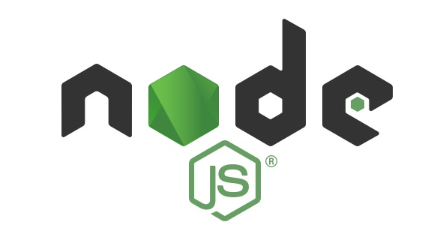
Node.js

Slide 2
Node.js Introduction
Node.js is an open source server environment
Node.js uses JavaScript(browser) on the server
how Node.js handles a file request:
Sends the task to the computer's file system.
Ready to handle the next request.
When the file system has opened and read the file, the server returns the content to the client.

Slide 3
Node Js REPL
The REPL feature of node js is very usefull in experimenting with node.js
codes and to debug javascript codes .
REPL stands for:
Read: The REPL reads user input (JavaScript code).
Eval: The input is evaluated (executed) by the JavaScript engine.
Print: The result of the evaluation is printed to the screen.
Loop: The process repeats (loops), waiting for the next input.

Slide 4
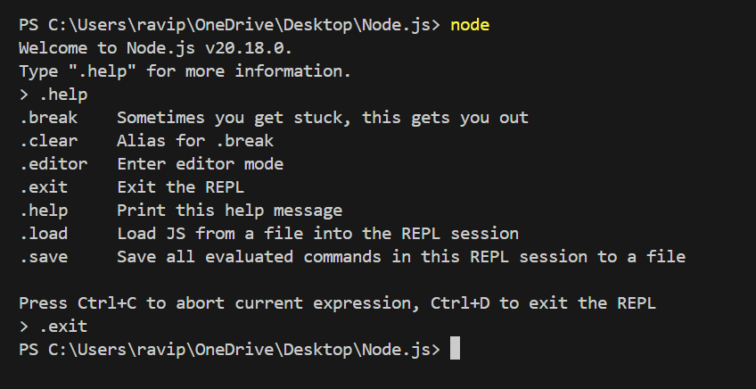
REPL Environment

Slide 5
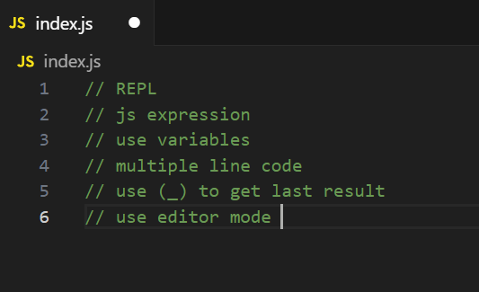
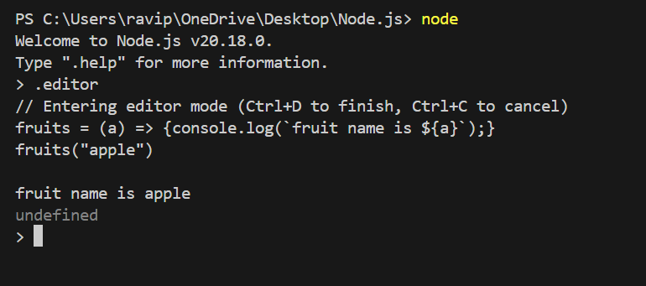
.editor

Slide 6
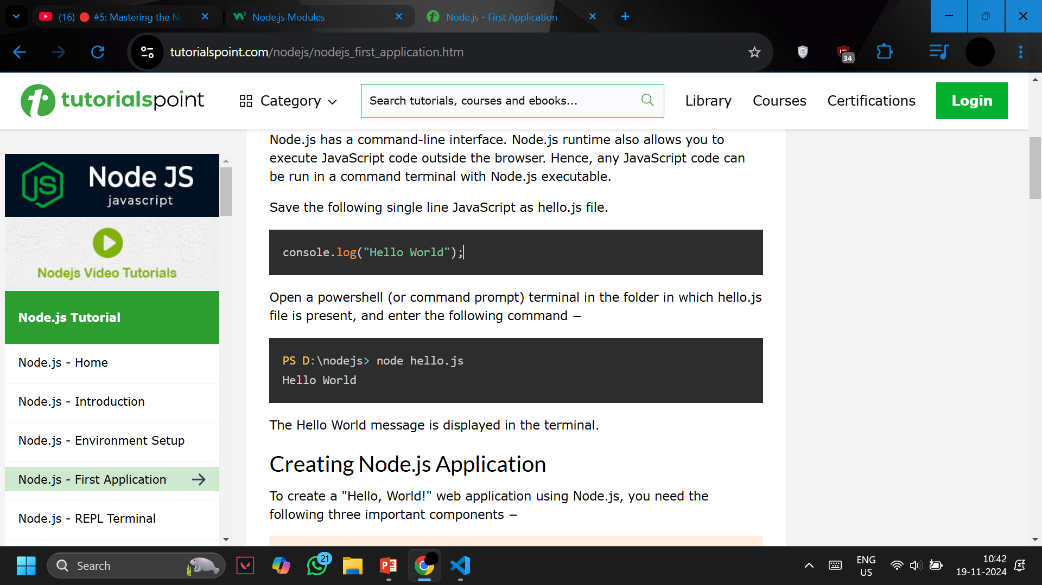
Node.js - First Application

Slide 7
Node.js Core Modules Read , Write (sync)
Consider modules to be the same as JavaScript libraries.
A set of functions you want to include in your application.
Node.js has a set of build in modules.

Slide 8
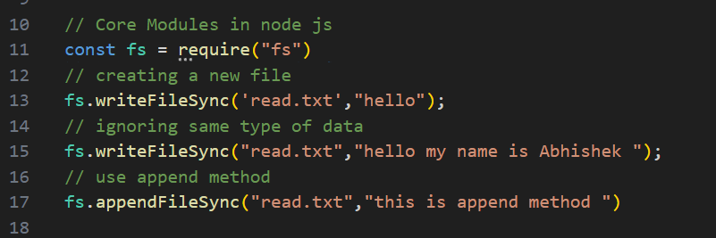
write file in node.js (sync method)

Slide 9
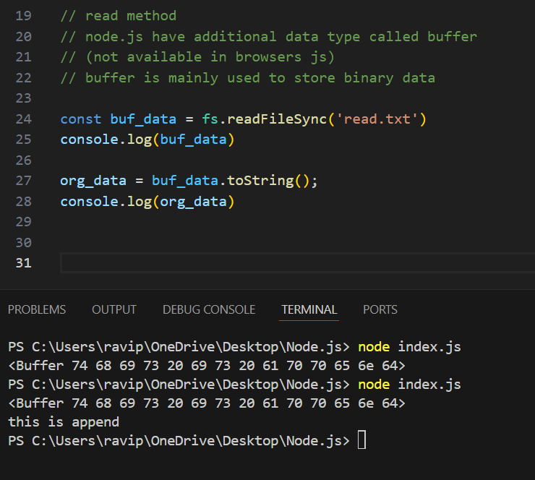
Read File in node.js (sync method)

Slide 10
Rename a file in node.js(sync Method)
fs.renameSync(“old path ” , ” new path”)

Slide 11
Delete a file in node.js using sync method
fs.unlinkSync(“ name of file “);

Slide 12
Node.js Modules(Asyn)
Callback function must required.
Asynchronous file methods take a callback function as their last argument.
The callback is executed once the operation completes (success or failure).
Errors during file operations are passed as the first argument to the callback.
It's essential to check for errors to ensure proper handling.

Slide 13
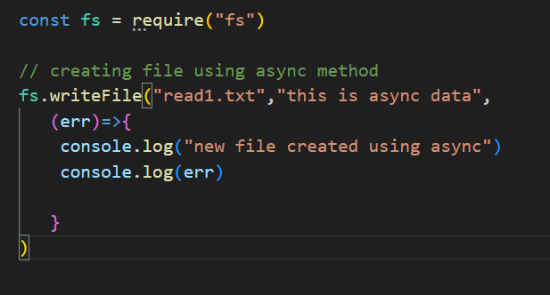
Creating file using async method

Slide 14
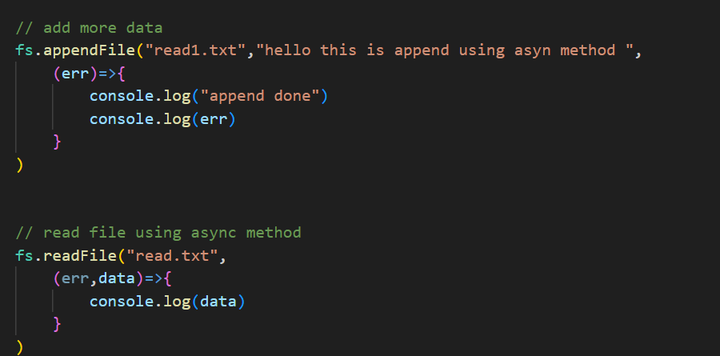
Append and read using async method

Slide 15
Convert Buffer data into String
Use - Unicode Transformation Format - 8-bit
“UTF-8”

Slide 16
Os module In node js
The node:os module provides operating system-related utility methods and properties.
It can be accessed using:
const os = require('os');

Slide 17
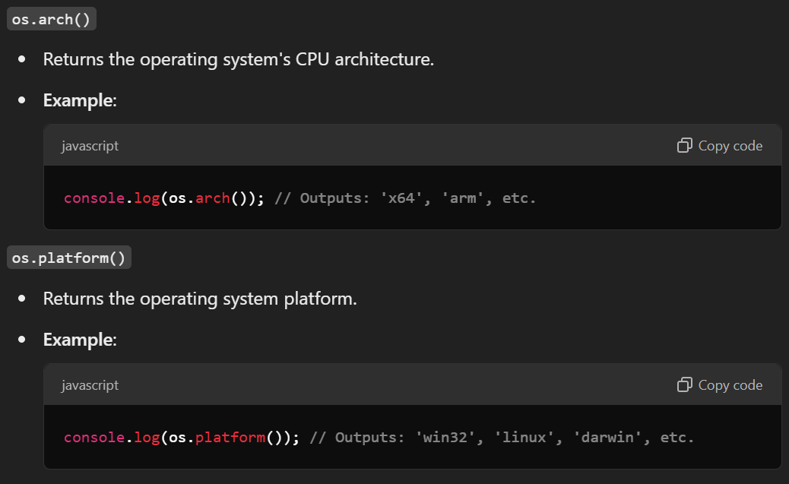
Commonly used methods in os module

Slide 18
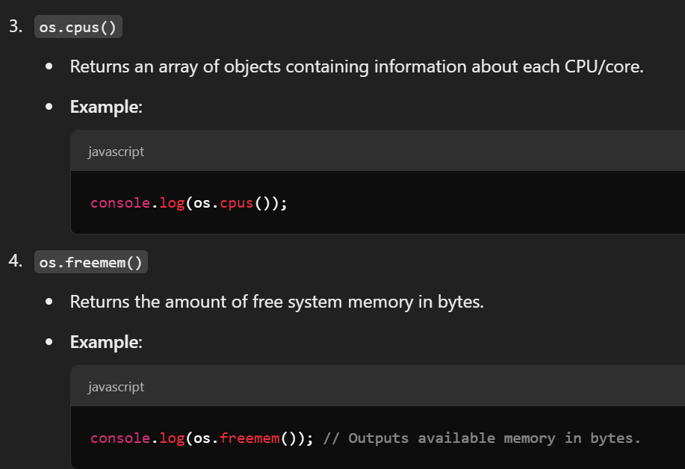
Os Module

Slide 19
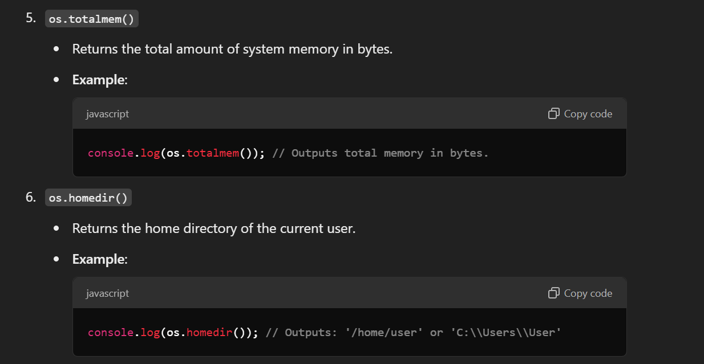
Os module

Slide 20
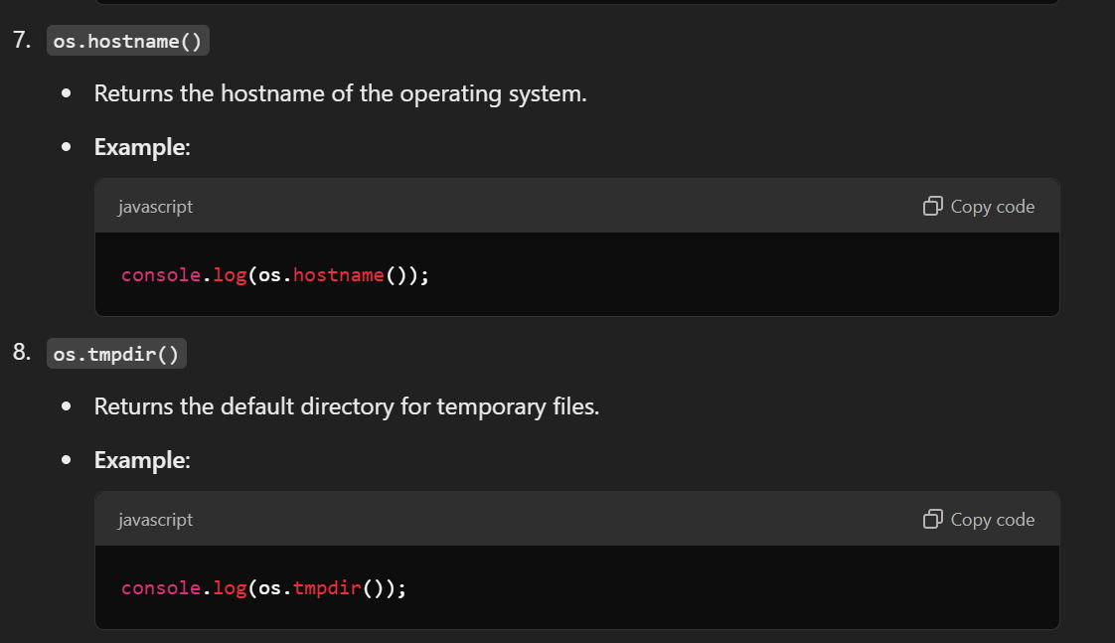
Os module

Slide 21
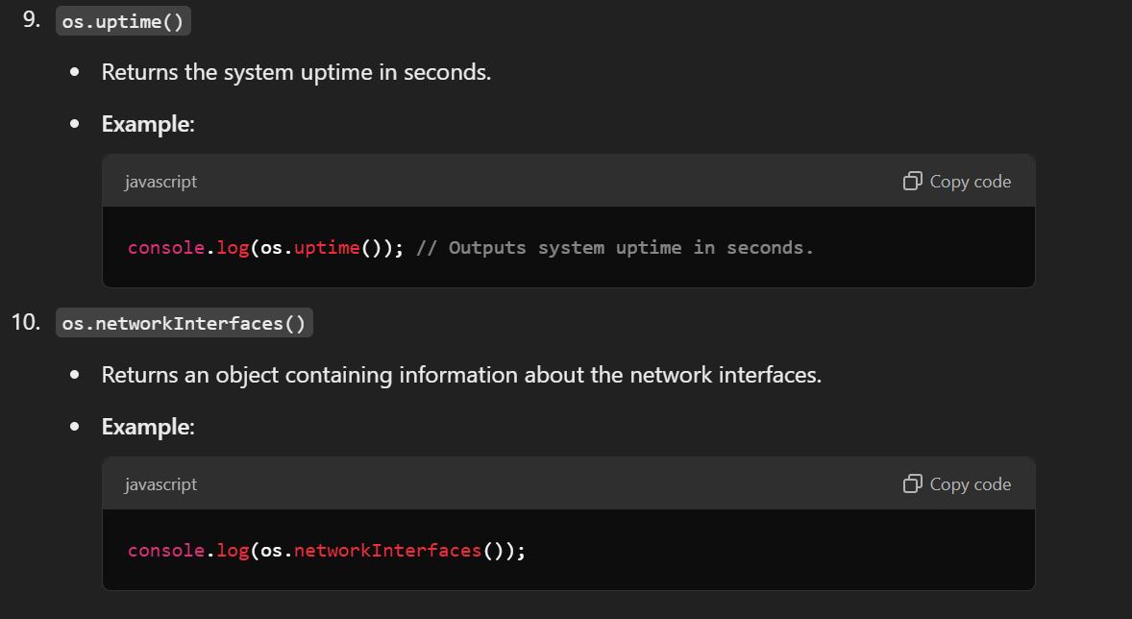
Os module

Slide 22
Create and Export Own module node.js
Export :
module.exports = name of variable , function you want to export
Import:
Create a variable = require(‘./ name of module’)

Slide 23
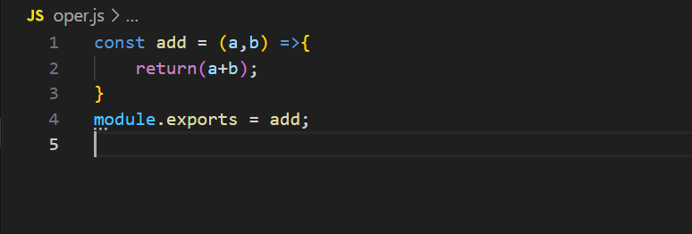
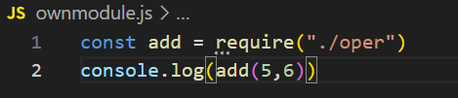
Example of import export module

Slide 24
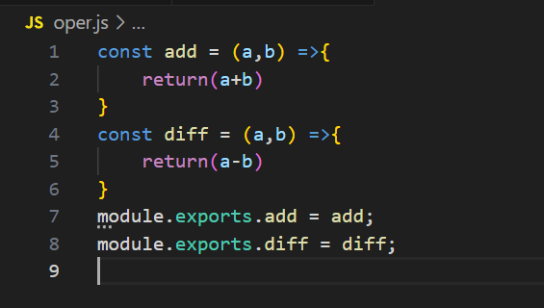
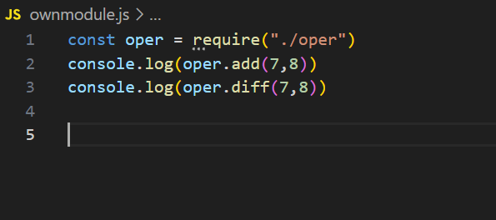
Import export multiple functions

Slide 25
Path Module in node.js
The path module provides utilities for working with file and directory paths.
It can be accessed using:
const path = require('path');

Slide 26
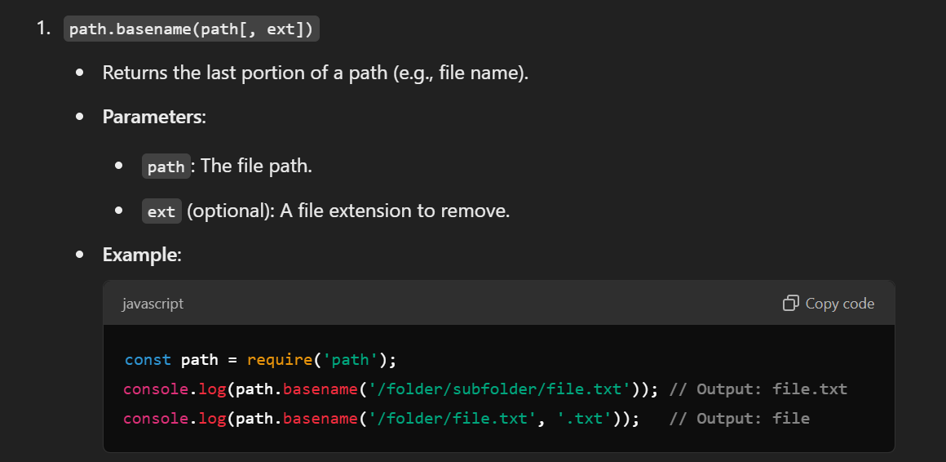
Path module

Slide 27
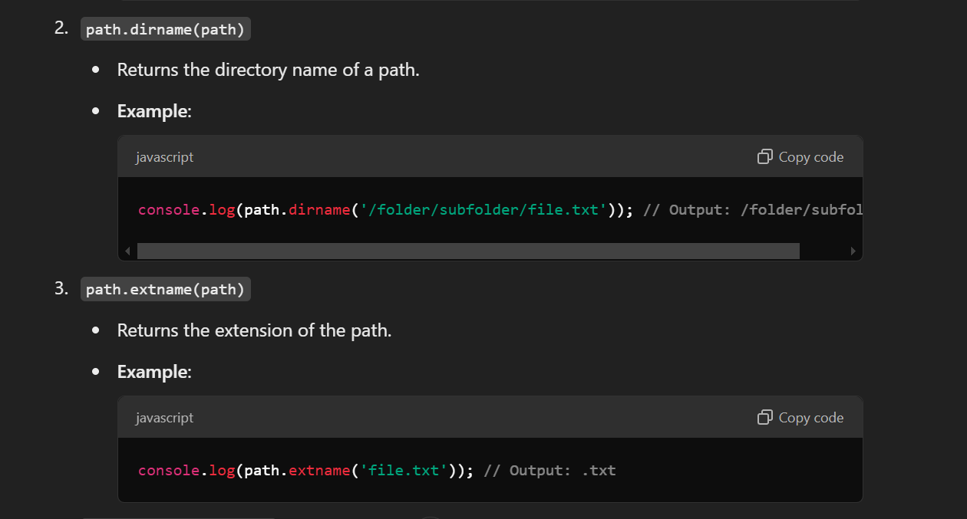
Path module example

Slide 28
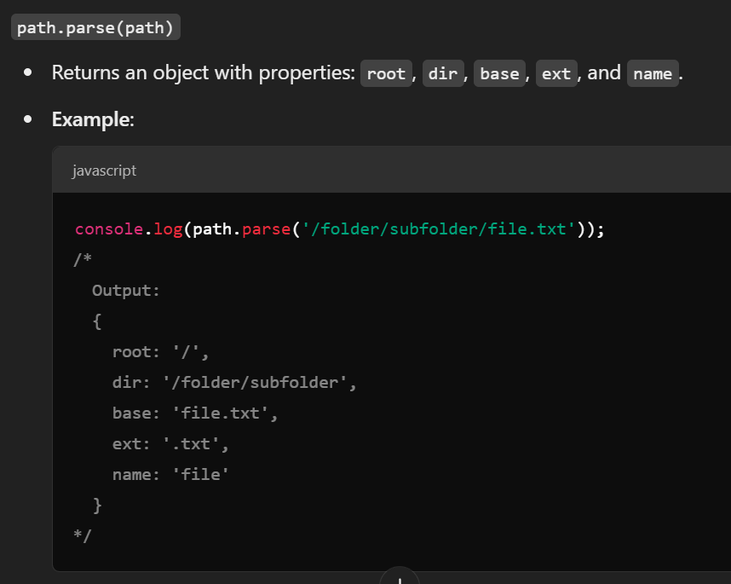
Path module example

Slide 29
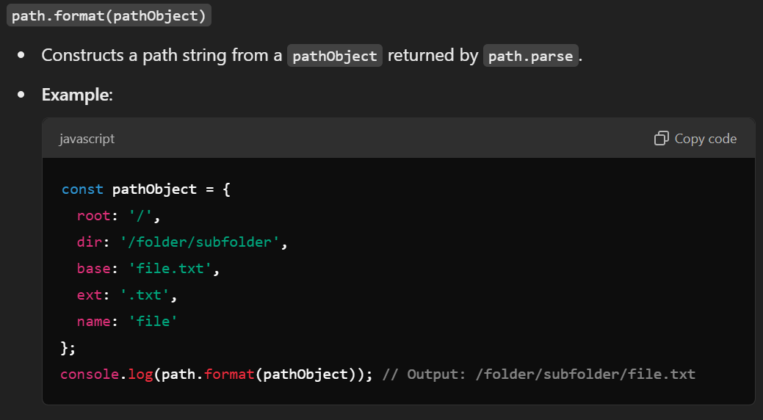
Path module example

Slide 30
NPM Module
NODE PACKAGE MANAGER
First initialize npm (terminal – npm init)
Create a new file called package.json

Slide 31
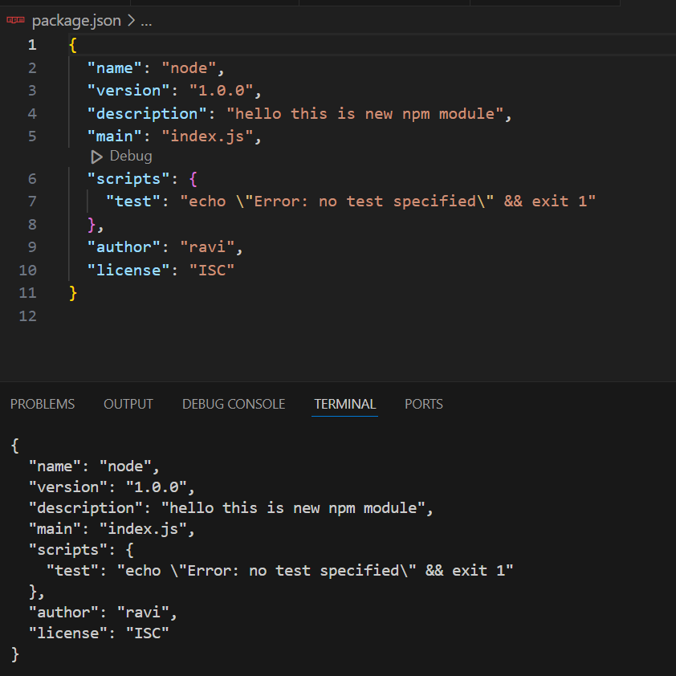
Npm module

Slide 32

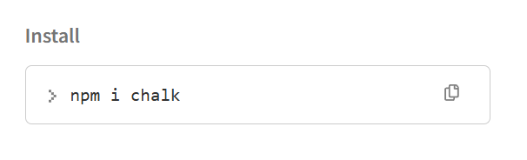
NPM dependecies or packages Chalk

Slide 33
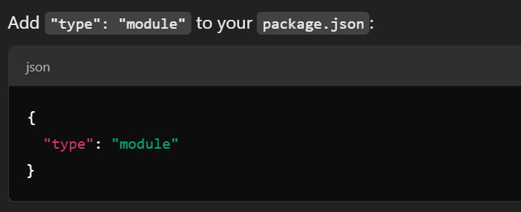
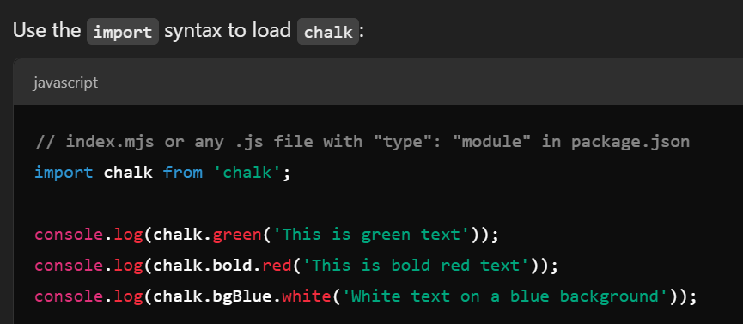
How to use chalk?

Slide 34
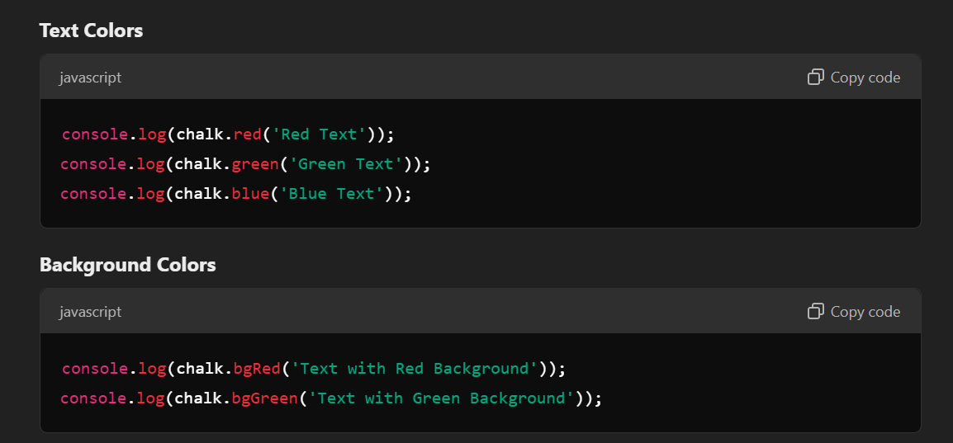
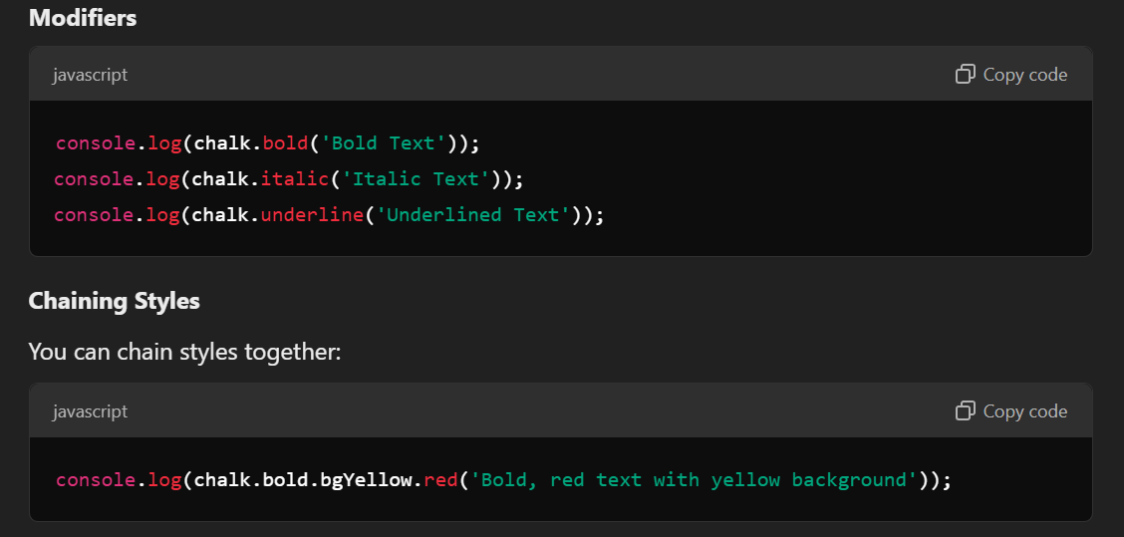

Slide 35
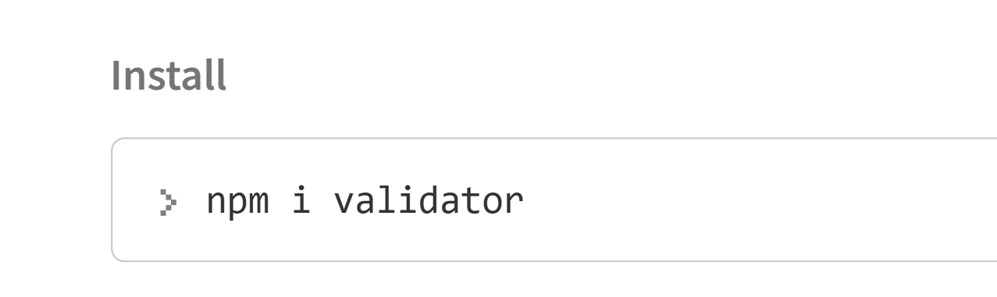
Validator In npm
The validator package is a popular library in Node.js used for validating and sanitizing strings. It provides a wide range of methods to check and manipulate strings, such as validating email addresses, URLs, and phone numbers, or sanitizing input data by trimming or escaping unwanted characters.

Slide 36
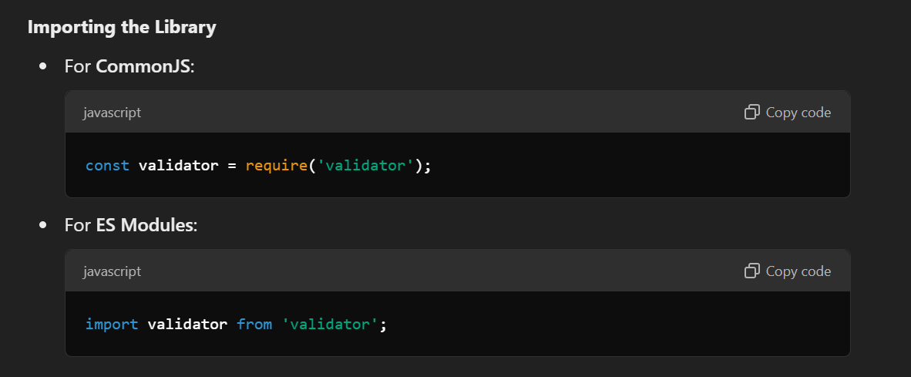
Import validator module

Slide 37
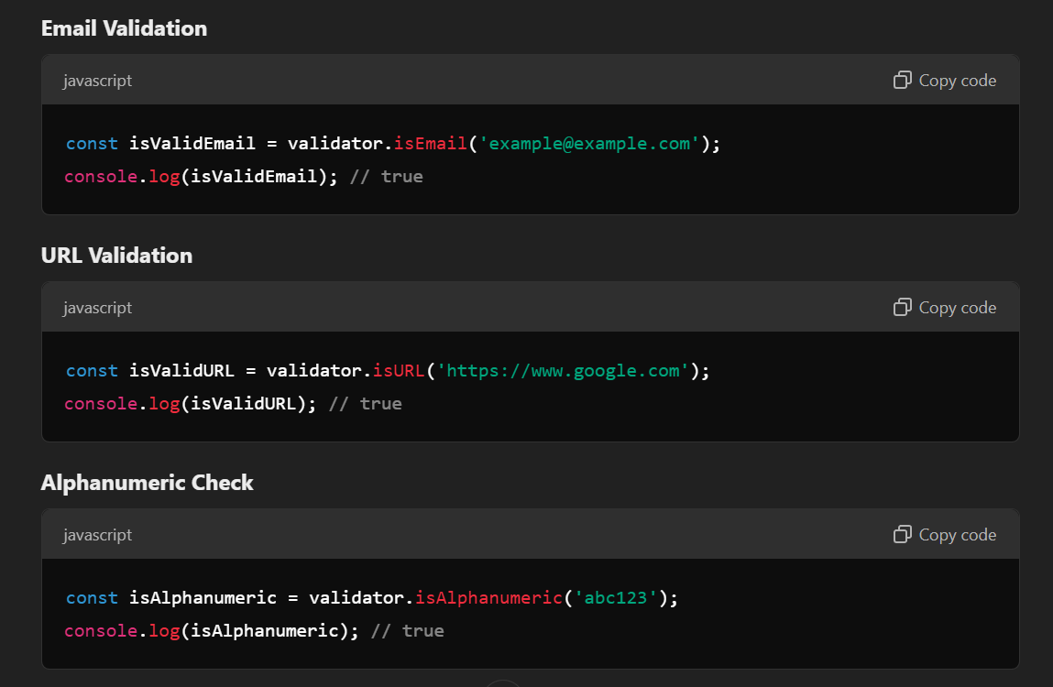
Common Validation Methods

Slide 38
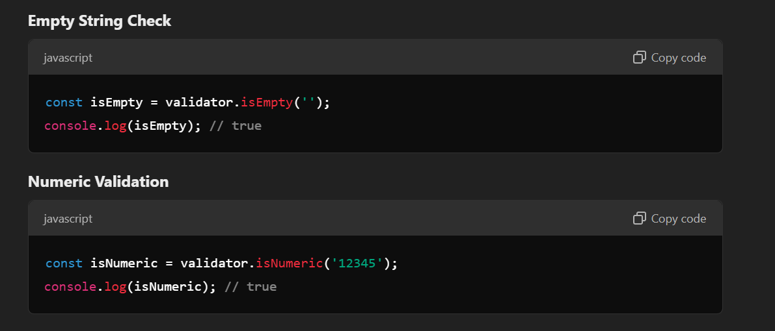
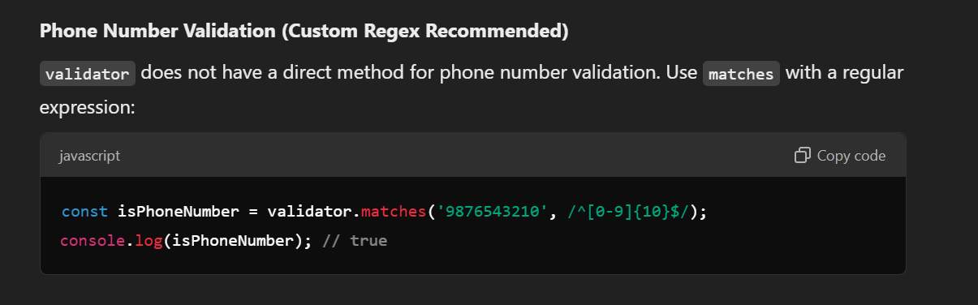
Common Validation Methods

Slide 39
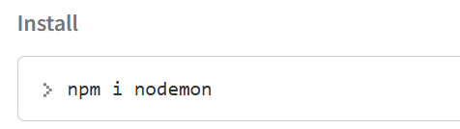
Import Global Modules in npm(nodemon)
Nodemon filename.js
What is Nodemon?
Nodemon is a development tool for Node.js applications that automatically monitors the files in your project for changes. When a change is detected, Nodemon restarts the application, saving you the hassle of manually stopping and starting the Node.js server
Nodemon -v

Slide 40
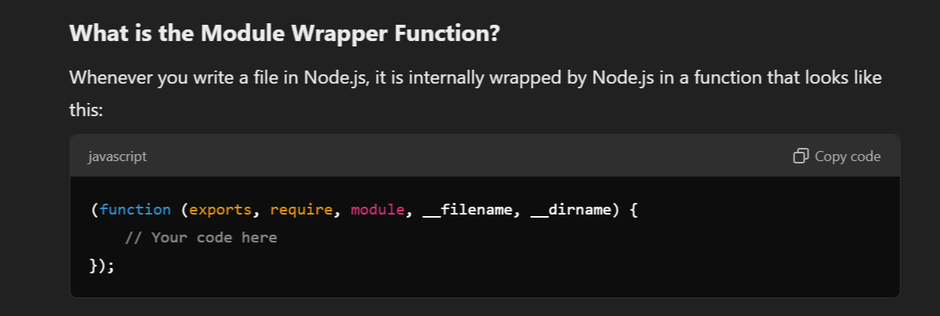
Module wrapper Function
The module wrapper function in Node.js is an important concept that ensures every file in a Node.js application operates as an isolated module.

Slide 41
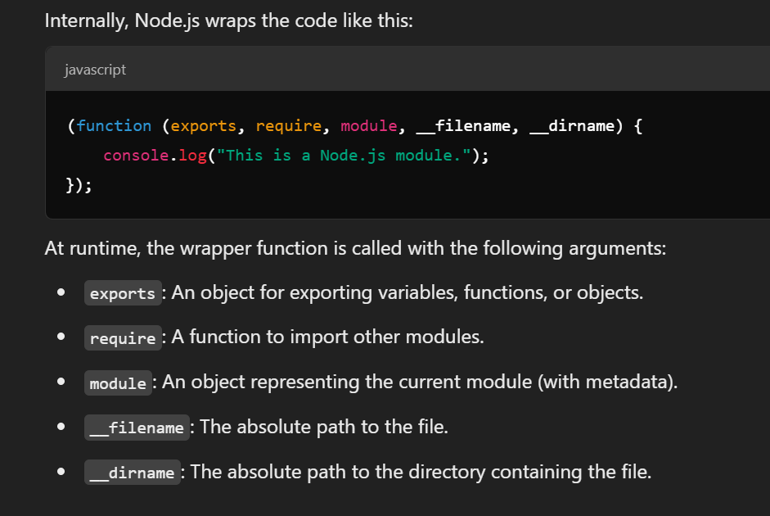
Module wrapper Function

Slide 42
Creating server In node.js with HTTP module
localhost refers to the local server or the machine on which your Node.js application is running.
It is typically associated with the loopback IP address 127.0.0.1.
When you host a Node.js application, you can configure it to listen for incoming requests on localhost or any other IP address.

Slide 43
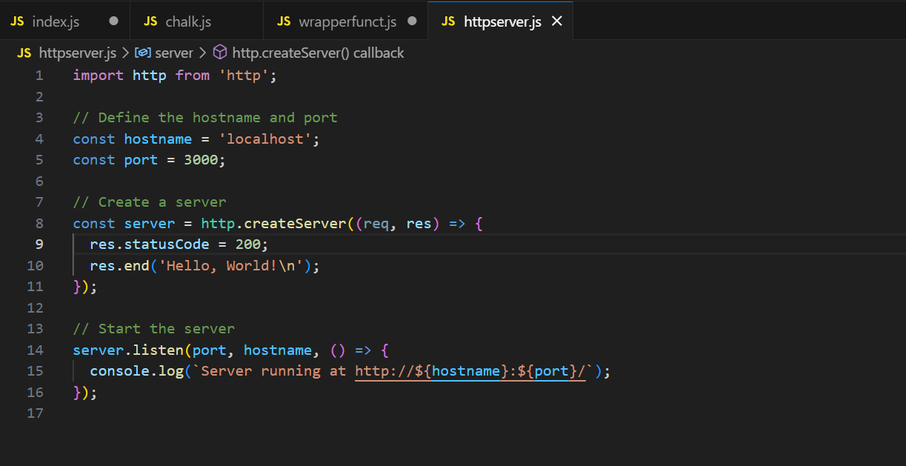
Creating server

Slide 44
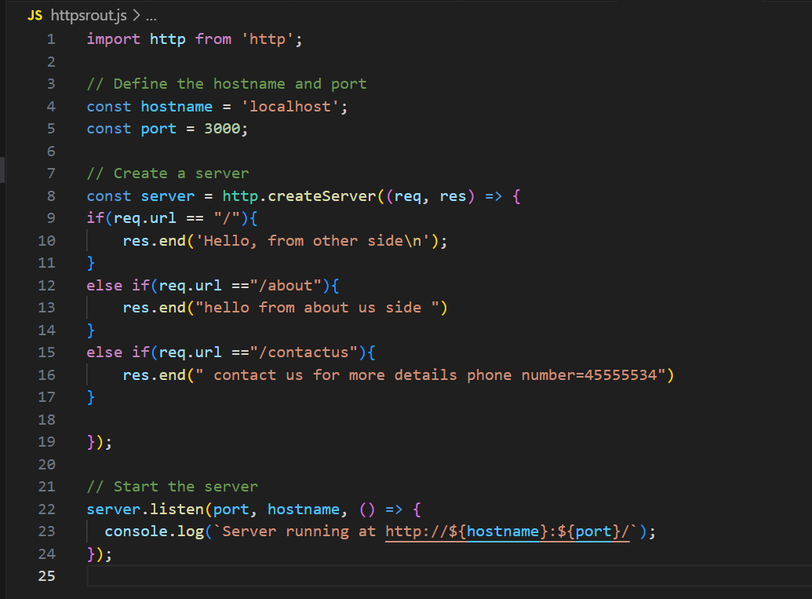
Node.js Routing Handled

Slide 45
JSON in node js
JSON stand for javascript object notation.
Format for storing and creating data.
Json is used when data is sent from a server to web page.

Slide 46
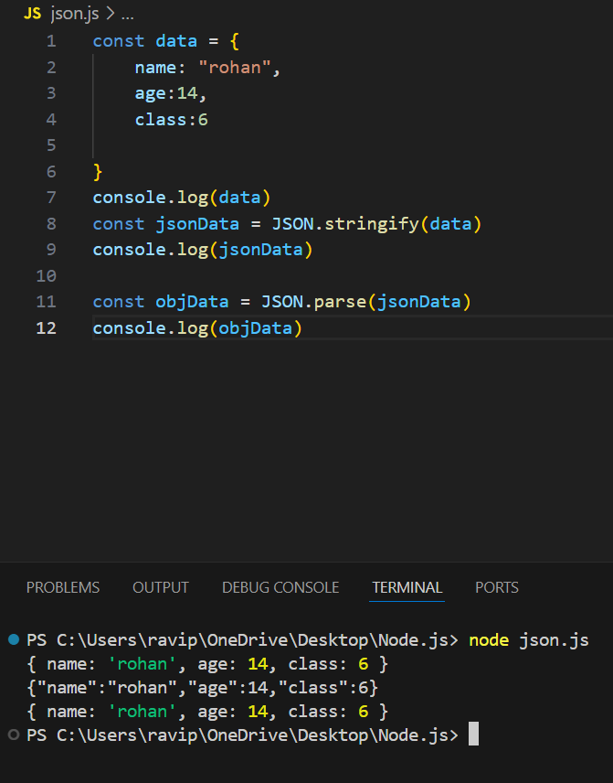
ObjData to Json format
Json to object Data

Slide 47
question
Create a object file
Write data in json format
Using fs method write or create a json file and transfer the json data into file

Slide 48
Events Module
EventEmitter: This is the core class for managing events. It allows you to register listeners and emit events.
on(): Method to register a listener for an event.
emit(): Method to emit an event, which triggers the listeners.
once(): Method to register a listener that will be invoked only once.
removeListener(): Method to remove a specific listener.
removeAllListeners(): Method to remove all listeners for an event

Slide 49
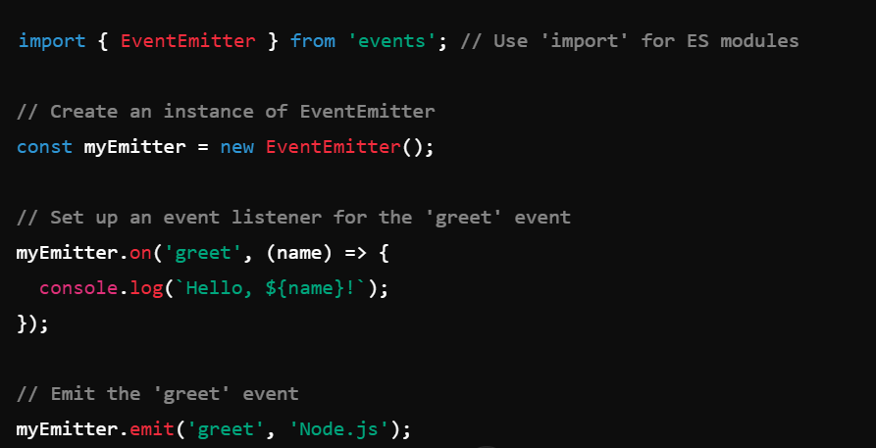
Example of event module

Slide 50
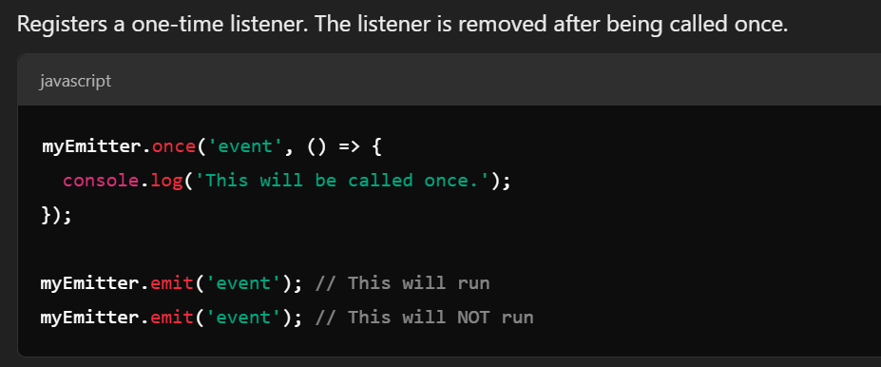
once(eventName, listener)

Slide 51
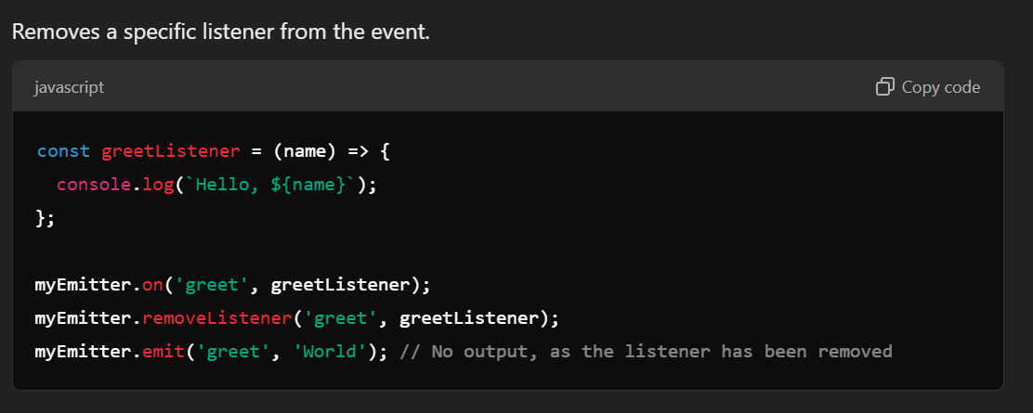
removeListener(eventName, listener)

Slide 52
Streams and buffers in node.js
In Node.js, streams are a way to process data in chunks, rather than all at once, which is more efficient and can help avoid memory issues. Streams are a key feature of Node.js development and can help with input/output (I/O) operations

Slide 53
Types of Streams
1. Readable Streams
Readable streams are used to read data from a source (like a file or a network request).

Slide 54
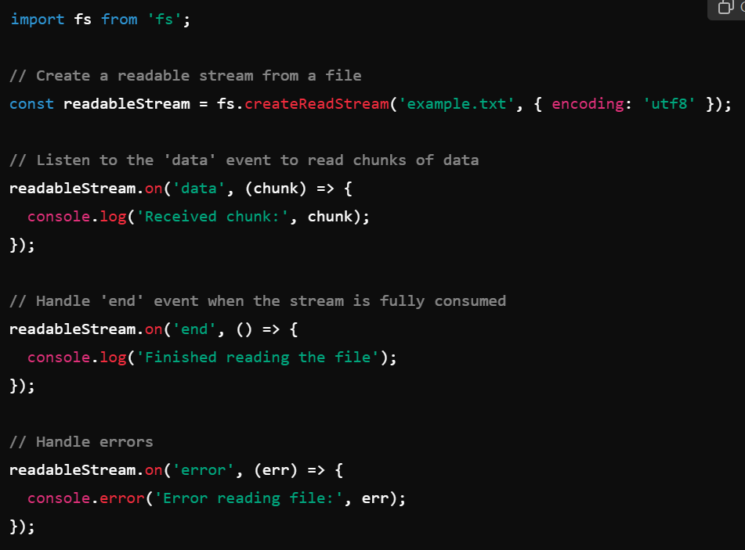
Example of readable stream

Slide 55
2. Writable Stream Example
Writable streams are used to write data to a destination (like a file or HTTP response).

Slide 56
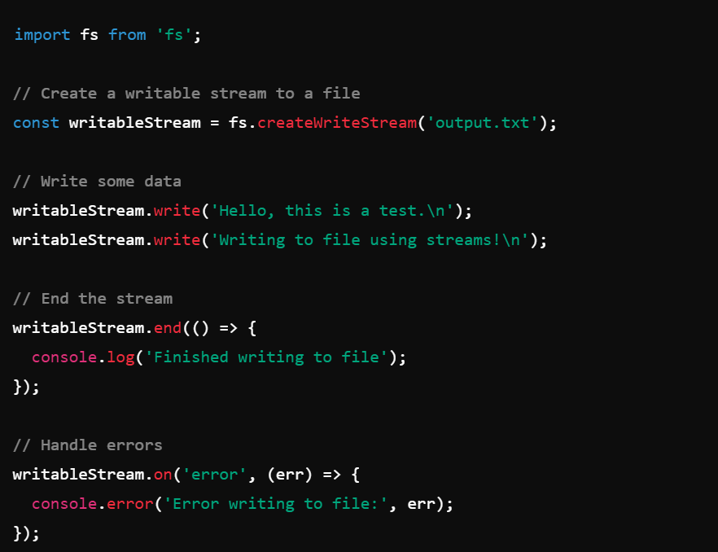
Example of writable streams

Slide 57
Duplex Streams
Purpose: Streams that can both read and write (e.g., TCP sockets).

Slide 58
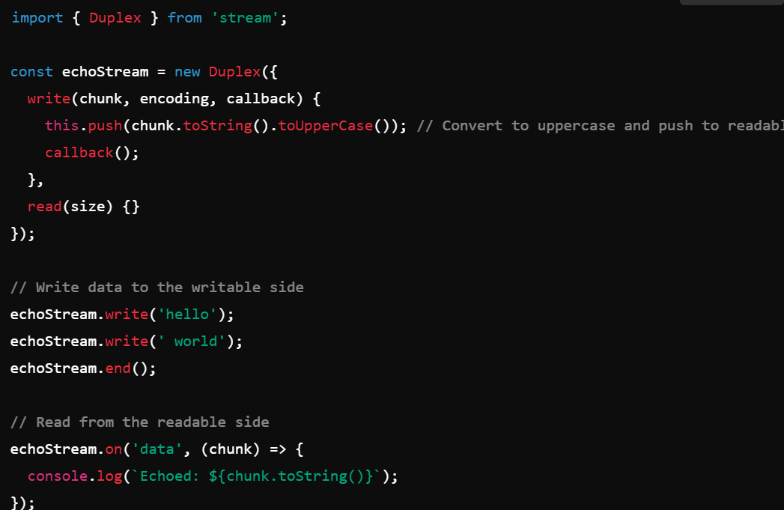
Example of duplex stream

Slide 59
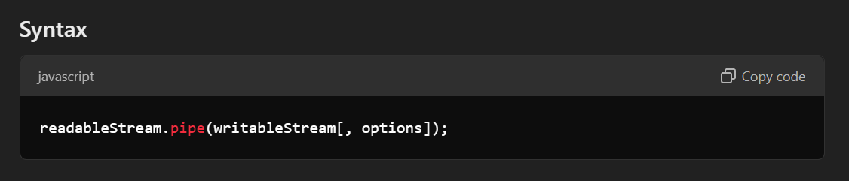
Stream.pipe()
The stream.pipe() method in Node.js is used to connect a readable stream to a writable stream, making it easier to pass data from one stream to another.

Slide 60
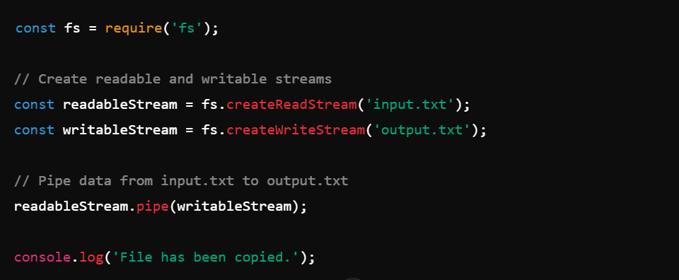
Example of pipe method

Slide 61
Express js
Express.js is a node.js framework .
Express.js is a web application framework that provides you with a simple
api to build web sites and web pages.

Slide 62
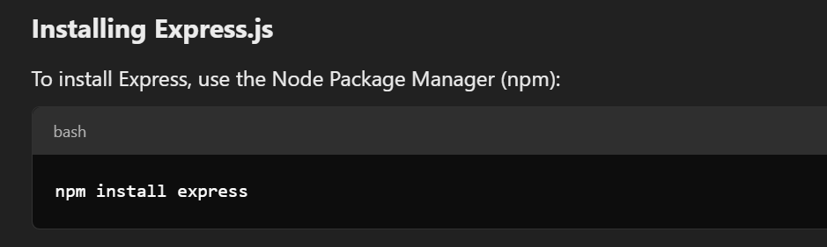
Need of express.js
Try to write small REST Api server.
Take 5-10x time less than node js and provide few lines of code.

Slide 63
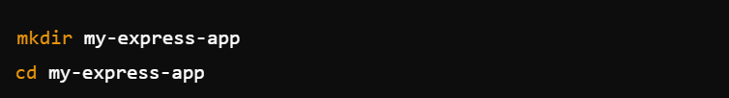
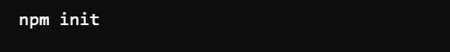

Installation of express.js
Create a new folder
Create a json file

Slide 64

Require or import express module in node.js

Slide 65

Express JS routing

Slide 66

Create Server using express

Slide 67

Router example

Slide 68


Send Json Data as a Response using express.js

Slide 69
Serve css ,html files
Create html , css ,js files : type nul > filename
To serve static files such as images, CSS files, and JavaScript files
, use the express.static built-in middleware function in Express.
// Middleware to serve static files from the “directory" directory
Function or var . use(express.static(‘directory name'));
Import path module in js file

Slide 70


linkhtmlcss.js

Slide 71

Template Engines in Express.js
Express.js supports a wide variety of template engines to create dynamic and maintainable HTML views.
Render different content for different users or requests.

Slide 72

Folder Structure

Slide 73

1.EJS (Embedded JavaScript Templates) Description : EJS allows you to embed JavaScript code within HTML. It's easy to learn and widely used.

Slide 74


Ejs Example

Slide 75

2.Pug () Description : Pug is a minimal and elegant template engine. It uses indentation-based syntax instead of closing tags.

Slide 76


Pug example

Slide 77

3.Mustache template engine :

Slide 78


Mustache :

Slide 79
Handlebars

Slide 80
Views directory
views, the directory where the template files are located. Eg: app.set('views', './views'). This defaults to the views directory in the application root directory.
Const templatePath = path.join(__dirname, ”__new folder”)
app.set( “views” , templatePath)

Slide 81

Partials in express.js
Partials are typically small chunks of HTML or layout, such as a header, footer, or navigation bar.
They are stored as separate files and included in main templates when needed.

Slide 82


Slide 83

Header partial
Static vs. Dynamic Content -
HTML in your header.hbs like <header> or <nav> doesn't need to change dynamically. It's part of the structure that remains the same across all pages, so you can write it as plain HTML.

Slide 84

Footer Partials
&copy; is an HTML entity used to display the copyright symbol (©) in HTML. It is a special code that tells the browser to render the copyright symbol in the text.
Use {{}} when you want to insert dynamic data (like variables, expressions, or helpers) into your template.

Slide 85

Partial.js or app.js file 1
In Node.js ES Modules (since type: "module" is set in package.json), __dirname is not natively available. The code above manually creates __filename and __dirname using fileURLToPath and path.dirname to mimic the behavior of JS.

Slide 86

Partial.js or app.js file 2

Slide 87

Partial.js or app.js file 3
Handlebars!' });

Slide 88

Git SSH Setup
Git SSH (Secure Shell) is a method used to securely authenticate and interact with Git repositories over the network. Instead of using HTTPS and typing your username and password each time, SSH allows secure, password-less authentication using an SSH key pair.
To collaborate
Track the history of code

Slide 89

GitHub is a popular platform for hosting and collaborating on software development projects. It is based on Git, a distributed version control system that allows multiple people to work on the same codebase simultaneously.

Slide 90


Git – Installation
Terminal – go to Git Bash

Slide 91


Git status -

Slide 92

Git init
The git init command is used to initialize a new Git repository in a directory. It sets up the necessary files and structure for Git to track changes in that directory.

Slide 93


Slide 94

Creating new files using Git and add file to Github

Slide 95


Slide 96






Slide 97


MongoDB is a document database. It stores data in a type of JSON format
A record in MongoDB is a document, which is a data structure composed of key value pairs similar to the structure of JSON objects.

Slide 98

Installation

Slide 99


Change path
C:\Program Files\MongoDB\Server\8.0\bin
Download shell msi

Slide 100

Add new connection in mongodb

Slide 101



Create Database
mongod –version
mongosh
Use - the use command is used to switch between databases or to create a new database.
Need atleast one data

Slide 102


Insertion of data

Slide 103

Showing collection or data
To exit use ctr+c → two times

Slide 104


CRUD Operation
Insert Multiple documents

Slide 105

CRUD Operation
Access single data

Slide 106

CRUD Operation MongoDB
Update Data

Slide 107

MongoDB Crud operation
Delete

Slide 108

MongoDb GUI Application

Slide 109


Slide 110

Mongoose
Mongoose is a Node.js library that provides a way to interact with MongoDB using an object-oriented approach. It allows you to define schemas for your data, perform CRUD operations, and add validations or middleware easily.

Slide 111

Mongoose connection with database
Database name
Mongoose operations (e.g., .connect(), .find(), .save()) return Promises because interacting with the database is time-consuming. async/await lets you handle these Promises easily.
Error Handling: With try...catch, you can handle errors more cleanly compared to .catch() in Promises.

Slide 112

CRUD operations using mongoose

Slide 113

CRUD operations using mongoose

Slide 114

CRUD operations using mongoose

Slide 115

CRUD operations using mongoose

Slide 116

CRUD operations using mongoose

Slide 117

Find Active users in Mongoose
index refers to the current element's index in the loop (which is a zero-based index, starting at 0). By adding 1 to index, you change the numbering to start from 1 instead of 0.

Slide 118
Bulk operations in mongoose
Bulk operations in MongoDB allow you to execute multiple operations (insert, update, delete, etc.) in a single network request.
This is particularly useful when you need to perform many operations at once, as it minimizes the overhead of multiple database round-trips, making it more efficient.
MongoDB supports bulk write operations through the bulkWrite() method.
It allows you to combine various types of operations like insertOne, updateOne, deleteOne, etc., into one single request.

Slide 119


Bulk operations in mongoose

Slide 120
Mongodb Query operators
MongoDB query operators are special symbols or keywords used in MongoDB queries to filter and manipulate data in a collection. They allow you to perform a variety of operations such as comparison, logical, array, and evaluation operations.

Slide 121



Slide 122

Mongodb Query operators

Slide 123

Mongodb Query operators

Slide 124

Mongodb Query operators

Slide 125

Mongodb Query operators

Slide 126


Mongodb Logical Operators

Slide 127

Validators in mongodb
Built-in Validation in Mongoose-

Slide 128



Example - Require , min , max validation

Slide 129


Example - minlength and maxlength: String Length Validation

Slide 130


Example - enum: Restricting Values

Slide 131


Example – Match

Slide 132
Validators in mongodb
Custom Validator

Slide 133
MongoDB Aggregation Pipelines
Aggregation operations allow you to group, sort, perform calculations, analyze data, and much more.

Slide 134


MongoDB Aggrigation example

Slide 135


MongoDB Aggrigation example

Slide 136

POSTMAN

Slide 137


Creating Own restfull Api

Slide 138

Creating Own restfull Api
mkdir APImongo
cd APImongo
npm Init
npm I express
npm I mongoose
npm I validator
Mkdir src (inside APImongo)
cd src -> type nul > app.js

Slide 139


Creating Own restfull Api

Slide 140

Creating Own restfull Api

Slide 141


Creating Own restfull Api

Slide 142

MongoDB Atlas is a fully managed cloud database service that simplifies deploying, maintaining, and scaling MongoDB databases.
MongoDB Atlas is a fully managed cloud database service that simplifies deploying, maintaining, and scaling MongoDB databases
MongoDB Atlas hosts your database in the cloud. MongoDB Compass is a tool to connect to that database (or any other MongoDB instance) and interact with it locally.

Slide 143


Slide 144


Slide 145


Slide 146


Slide 147
JWT Auth
JWT Auth (short for JWT Authentication) is a method of securing web applications using JSON Web Tokens. It allows a server to verify a user’s identity and grant or deny access to protected resources without needing to store session data on the server.

Slide 148


